Slide 1

Physics in the Home

Slide 2
Thermodynamics
branch of physics concerned with heat and its relation to other forms of energy and work.

Slide 3
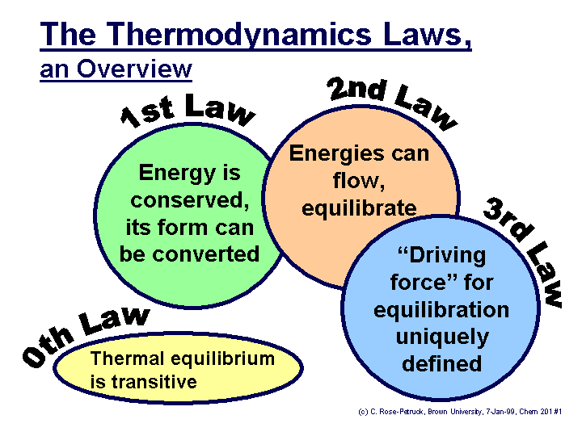

Slide 4
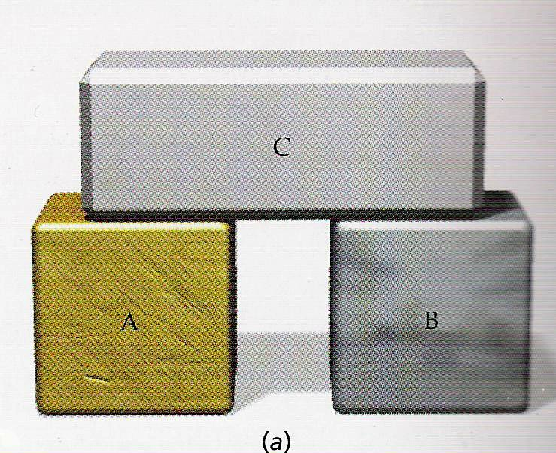
Zeroth Law of Thermodynamics
“If body A is in thermal equilibrium with body C, and B is in thermal equilibrium with C, then A is in Thermal equilibrium with B”
If T_{A} = T_{C}; and T_{B}=T_{C} then T_{A}=T_{B}

Slide 5
Zeroth Law of Thermodynamics
If two objects are in thermal equilibrium with a third object, then they are in thermal equilibrium with each other.
If T_{A} = T_{C}; and T_{B}=T_{C} then T_{A}=T_{B}

Slide 6
Zeroth Law of Thermodynamics
Thermal equilibrium
same temperature
no net heat transfer

Slide 7
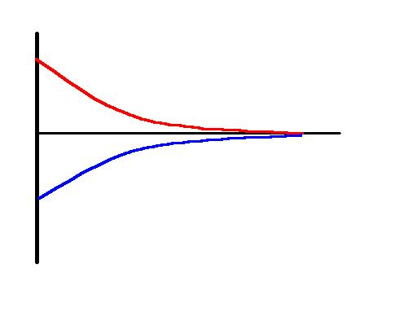
Two bodies with different temperatures
If T_{A}>T_{B} (initially)
Thermal equilibrium
T_{A}
T_{F}
T_{B}
Transfer of heat
No net heat transfer
time

Slide 8
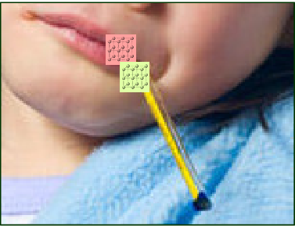
Thermal Equilibrium
Temperature of the Human body = temperature of thermometer

Slide 9
The First Law of Thermodynamics

Slide 10
System
surroundings
system
System can interact with the surrounding or other system(s) → changes could occur

Slide 11
System
surroundings
system
Quantities to monitor:
Heat (Q)
Work (W)
Internal energy (U)

Slide 12
Heat (Q)
surroundings
system
Heat removed = - Q
Heat absorbed = +Q

Slide 13
Work
F = force
Δx = displacement
P = pressure
A = area

Slide 14
Work
V = volume
Work done if there is a change in volume

Slide 15
Work
volume expansion = +W
volume contraction = - W
surroundings
system
Work done on the system = - W (system will contract)
Work done by the system = + W (system will expand)

Slide 16
Internal Energy, U
Total potential and kinetic energy of the system
Proportional to temperature
ΔU = + → increase temperature
ΔU = - → decrease temperature

Slide 17
The First Law of Thermodynamics
Work (W) → Change in volume
Change in internal energy (ΔU) → Change in temperature

Slide 18
The First Law of Thermodynamics
Q = +
Expand
(W = +)
Hotter
(ΔU=+)

Slide 19
Special Cases of the First Law

Slide 20
Adiabatic Process
Q = 0 → No heat transfer/exchange between the system and the surrounding
If the system expand (W = +) , it will become cooler (ΔU = -)
If the system contract (W = -) , it will become hotter (ΔU = +)

Slide 21
Isochoric Process
Constant volume (ΔV= 0→ W = 0)
Heat → entirely used to change internal energy (change in temperature)

Slide 22
Isothermal
Constant temperature (ΔU = 0)
Heat → converted entirely to work (change in volume)

Slide 23
Second Law of Thermodynamics

Slide 24
Second Law of Thermodynamics
Energy is always conserved, but some forms of energy are more useful than the others.

Slide 25
Second Law of Thermodynamics
deals with the preferred directions of thermodynamic processes
Some process occurs spontaneously, while other need work to be accomplished
Preferred direction? Direction of spontaneous change?

Slide 26
2nd Law of Thermodynamics
Clausius Statement
Heat Engine Statement
Refrigerator Statement
Entropy Statement

Slide 27
Clausius Statement
“Heat cannot, by itself, pass from a colder to a warmer body”
Note: The phrase “by itself” is very important !!!
Warm to Cold → Spontaneous
Cold to Warm → Not spontaneous (Work is needed to be done)

Slide 28
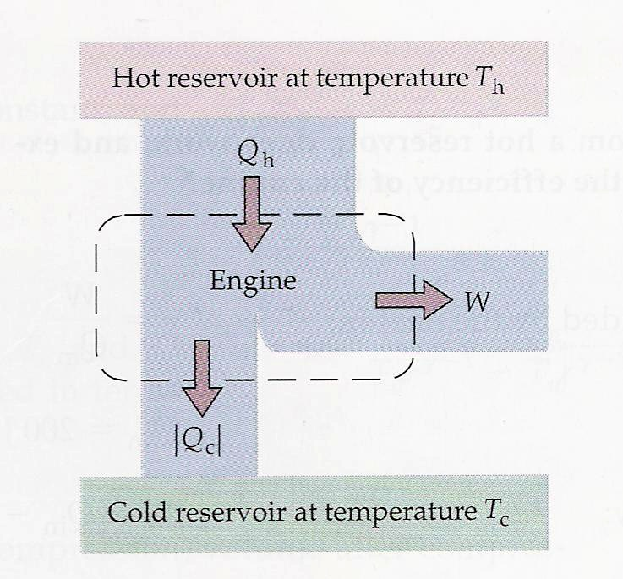
HEAT ENGINES
a cyclic device whose purpose it to convert as much heat input into work as possible.
1. Heat input (Q_{h}) from a HOT reservoir
2. Mechanical work (W) is done
3. Heat loss (Q_{c}) at the COLD reservoir

Slide 29
HEAT ENGINES
Efficiency (ε):
W = work output
Q_{h} = Heat input from a HOT reservoir

Slide 30
HEAT ENGINES
We want:
All “heat input” is converted to work.
No heat loss at the cold reservoir (Q_{c} = 0).
However…..

Slide 31
Heat Engine Statement:
It is impossible for a heat engine working in a cycle to produce no other effect than that of extracting thermal energy from a reservoir and performing an equivalent amount of work!”
Implications:
There is always heat loss (Q_{c}) at the cold reservoir
Conversion of Heat input (Q_{h}) to work (W) is not 100%.

Slide 32
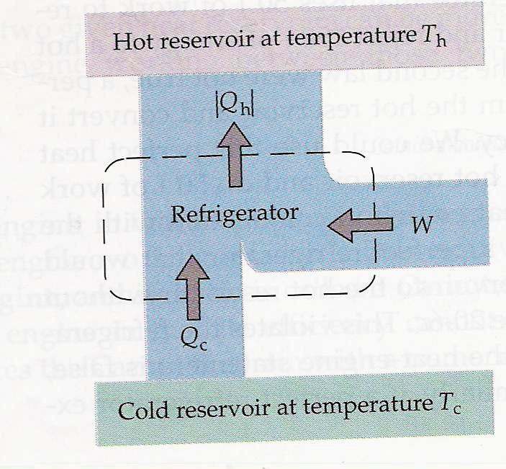
Refrigerators
A Refrigerator is a heat engine, run backward!
Work is needed to extract thermal energy from the refrigerator (cold reservoir) and transfer it to the surroundings (hot reservoir)

Slide 33
Refrigerator Statement
It is impossible for a refrigerator working in a cycle to produce only the effect of extracting heat from a cold object and reject the same amount of heat to a hot object
Interpretation:
Cold to warm → not spontaneous (need work to accomplish!!!) (Similar to Clausius Statement)

Slide 34
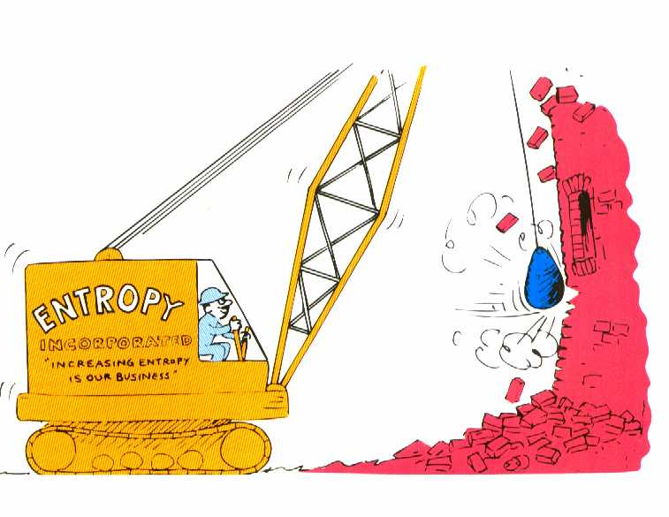
Entropy
Measure of the amount of disorder
Measure of how much energy or heat is unavailable for conversion into work

Slide 35
Entropy Statement
Natural systems tend to proceed toward a state of greater disorder
Interpretation:
Order to disorder → Spontaneous
Disorder to order → Not spontaneous (Work is needed to be done)

Slide 36
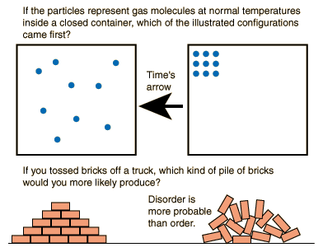

Slide 37
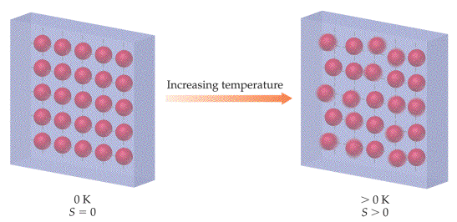
Third Law of Thermodynamics
“The entropy of a perfect crystal at absolute zero (T = 0K) is zero.”

